Slide 1

The Efficacy of the Equine Gestalt Coaching Method

Slide 2
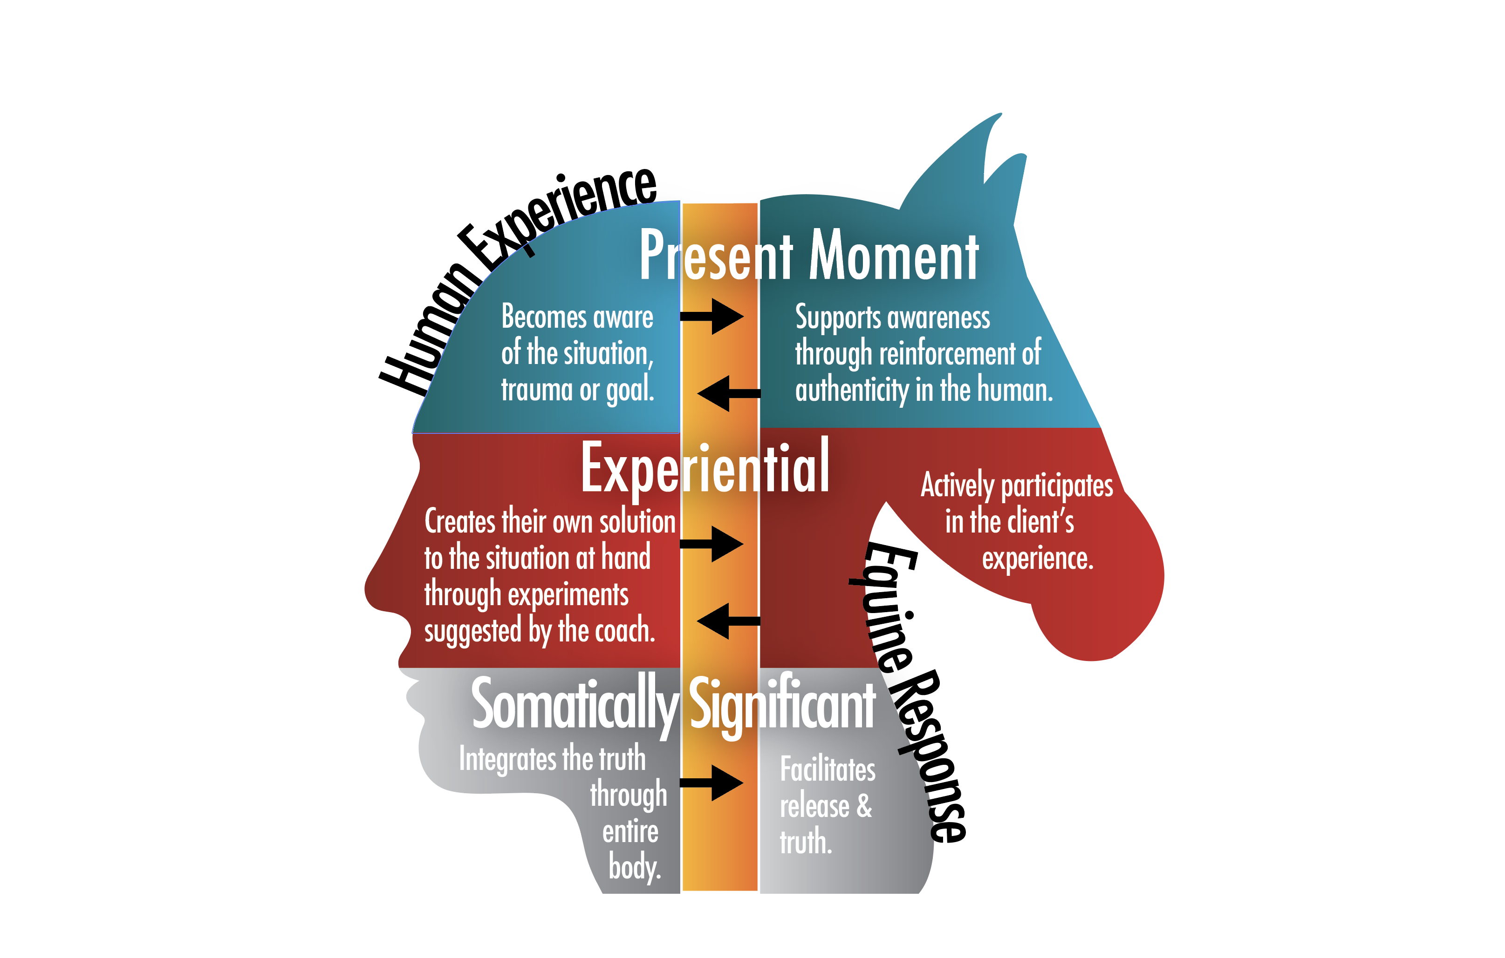
How & why a horse coaching session works …

Slide 3
The EGCMethod Coach works in partnership with a Horse Coach
EGCMethod sessions are freeform with human and equine both guiding the client toward resolution.
Equines are almost always at liberty and free to chose their interaction with the client.
The equine’s contributions to the session are appreciated and encouraged but in no way forced or coerced.
The Gestalt methodology allows for experiential exploration of the client’s needs in the moment.
The EGCMethod Coach is highly trained to handle any situation that might arise in the client.

Slide 4
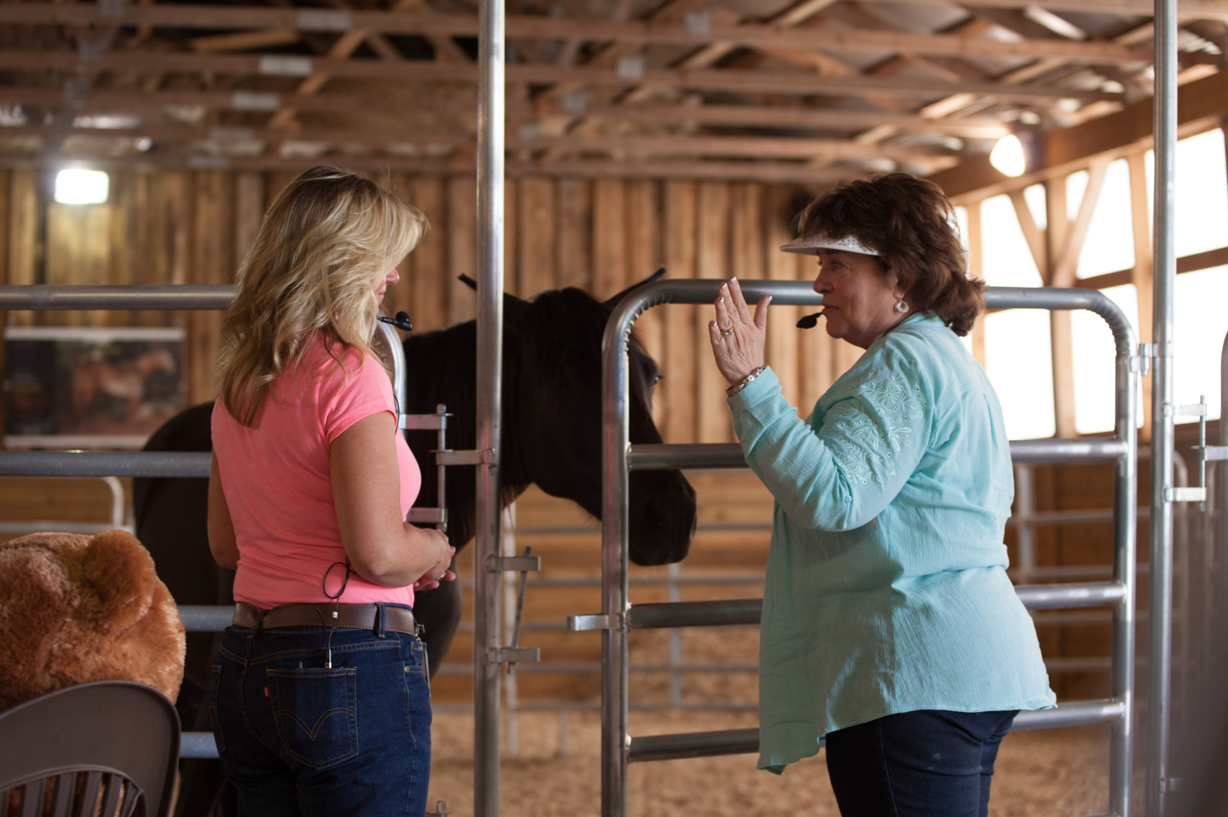

Slide 5
Two Decades of Applied Practice in Partnership with Horses
Developed by Horse/Human Healing Movement leader Melisa Pearce who successfully used the method in her own private practice.
The Touched by a Horse Equine Gestalt Coaching Method Certification Program was developed in 2008.
There are over 150 EGCMethod Certified Practitioners in the USA, Canada and other international locations.
The program is a two-year curriculum taught through teleclasses, online programs, and 8 hands-on intensive CORE trainings plus business development training.
Practitioners are supported through the Equine Gestalt Coaching Association and on-going education requirements to maintain their certification.

Slide 6


Slide 7
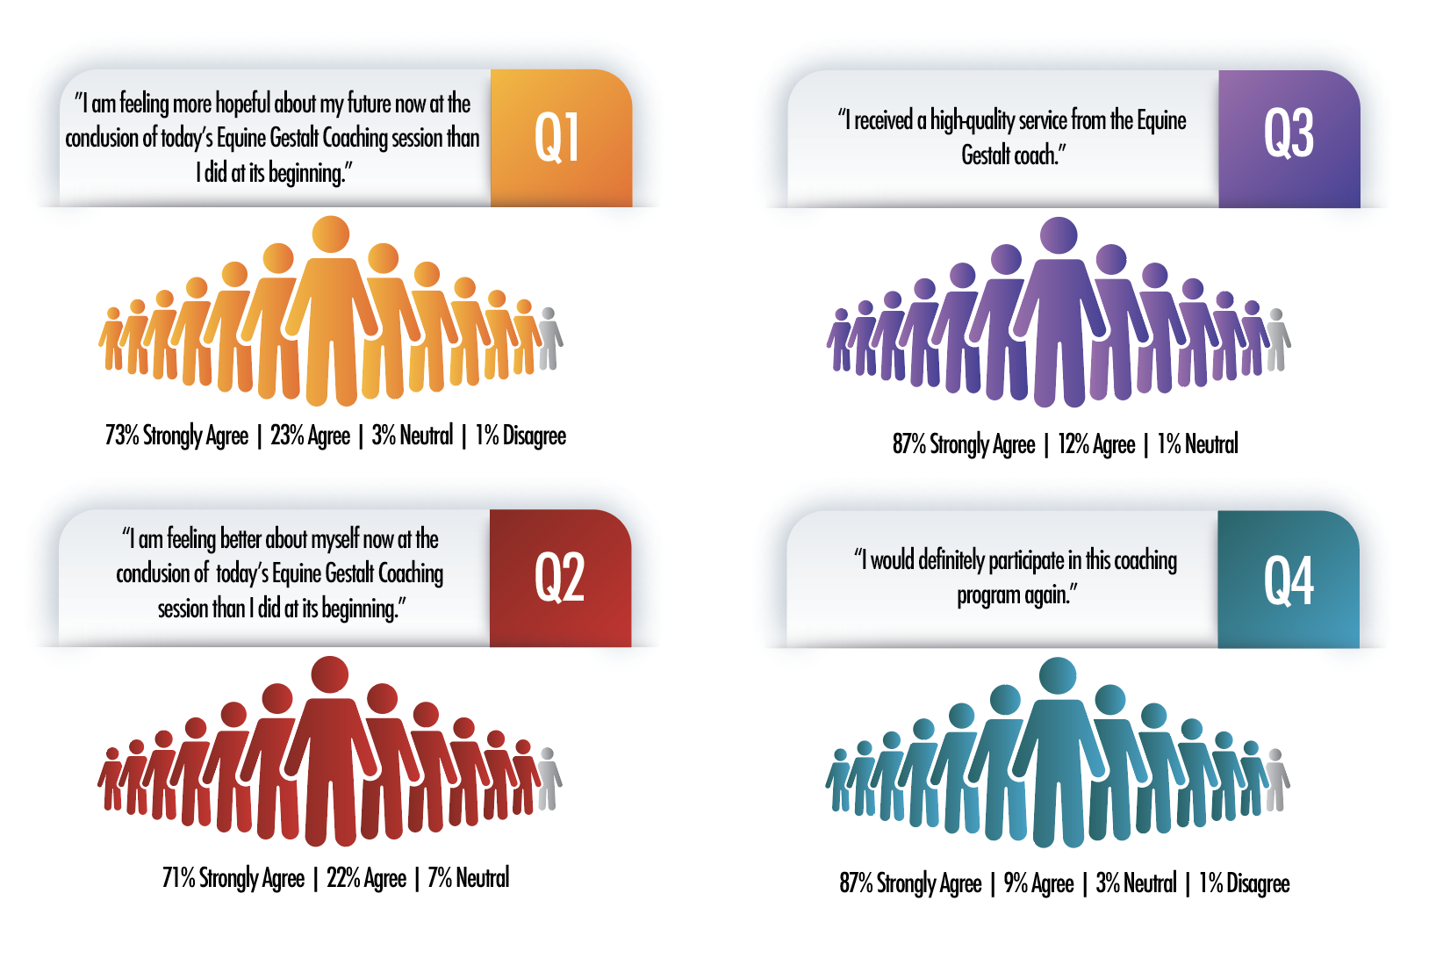
Study is in process through 1/1/2019. Conducted by: Jaclyn S. Manzione, M.S., EGCM Certified Practitioner,
Lead Analyst G. Thomas Manzione, Ph.D., LPC, Analyst
t
Notes:
The demographics of the populations being studied include addiction and recovery clients; youth in crisis; attorneys and members of the legal profession; pre-teens, teens and family members; dentists; and small business owners. All surveys collected are being included in the data analysis.
The information on this infographic represents 180 survey results from the above population mix.
Study is in process through 1/1/2019. Conducted by: Jaclyn S. Manzione, M.S., EGCM Certified Practitioner, Lead Analyst G. Thomas Manzione, Ph.D., LPC, Analyst
See abstract below for more details.
STUDY TITLE: Quantifying Outcomes of the Equine Gestalt Coaching Method in 2018 on Multiple, Diverse Populations
BACKGROUND & STATEMENT OF PROBLEM: The Equine Gestalt Coaching Method® was developed by Melisa Pearce in 1989. The experiential nature of the method involves the horse as an active partner with the coach in the client’s exploratory journey. The integrative approach of the equine-coach partnership and Gestalt methodology assists the client in their healing process. This research project is designed to demonstrate the efficacy of the Method on multiple, diverse populations.
STUDY AIM & OBJECTIVES/DURATION OF STUDY: Our twelve month long study (2018) currently in process, examines the relationship between the EGC Method and the feelings/emotions of our clients, clients’ perception of the quality of services received and clients’ continuing interest in participation in the Method.
STUDY DESIGN/DATA COLLECTION METHOD: Data is being collected at the conclusion of each EGCM session by six EGCM certified coaching practitioners, all who serve differing populations, using a Likert Item questionnaire that represents each client’s scaled responses to four questions.
STUDY POPULATION & SAMPLING: The demographics of the populations being studied include addiction and recovery clients, youth in crisis, attorneys and members of the legal profession, pre-teens, teens and family members, Dentists and Small Business Owners. All surveys collected are being included in the data analysis.
DATA ANALYSIS/OUTCOME/RESULTS: A frequency analysis of the sample data is identifying the statistical Mode (most repeated response) for each Likert Item question on the questionnaire. Data from each individual population surveyed is being analyzed separately then combined and subjected to a summary analysis. The study will continue through the end of the year. At that time, the results of the final summary analysis will be reported via descriptive statistics.
Submitted By:
Jaclyn S. Manzione, M.S., EGCM Certified Practitioner, Lead Analyst
G. Thomas Manzione, Ph.D., LPC, Analyst

